Slide 1
GUIDELINES
ADMA
2021-2025

Slide 2
INDEX
01
Presentation
Sources
06
Ways
Teams – Goals
Coordinator – Methodology
Time - Presentation
02
Objectives
Initiate. Give, Build
03
07
Areas
Identity
Formation
Mission
Spirituality
Timeline
2021-2022…
2022-2023…
2023-2024… …
04
08
How
Communication
Attitudes
Faith
Calendar
Annual ADMA
09
05
Dynamics
Ongoing prayer
Differentiated meetings
Monthly emails
Consideration teamwork
ADMA
Spiritual Animator
Formation (1, 2)
Initiate ADMA

Slide 3
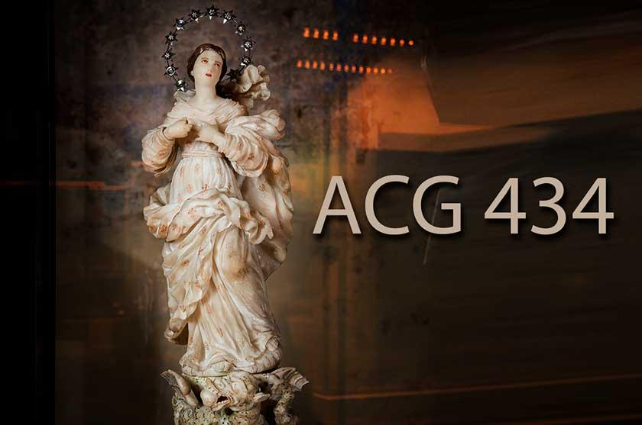
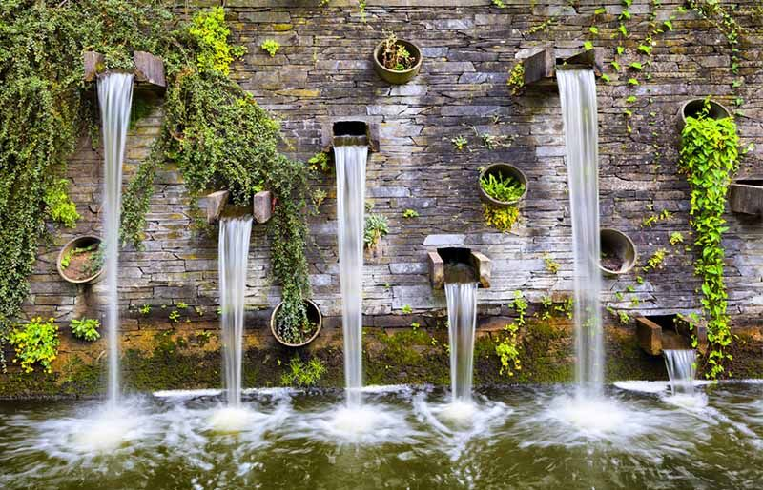
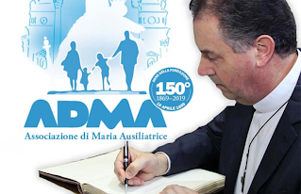
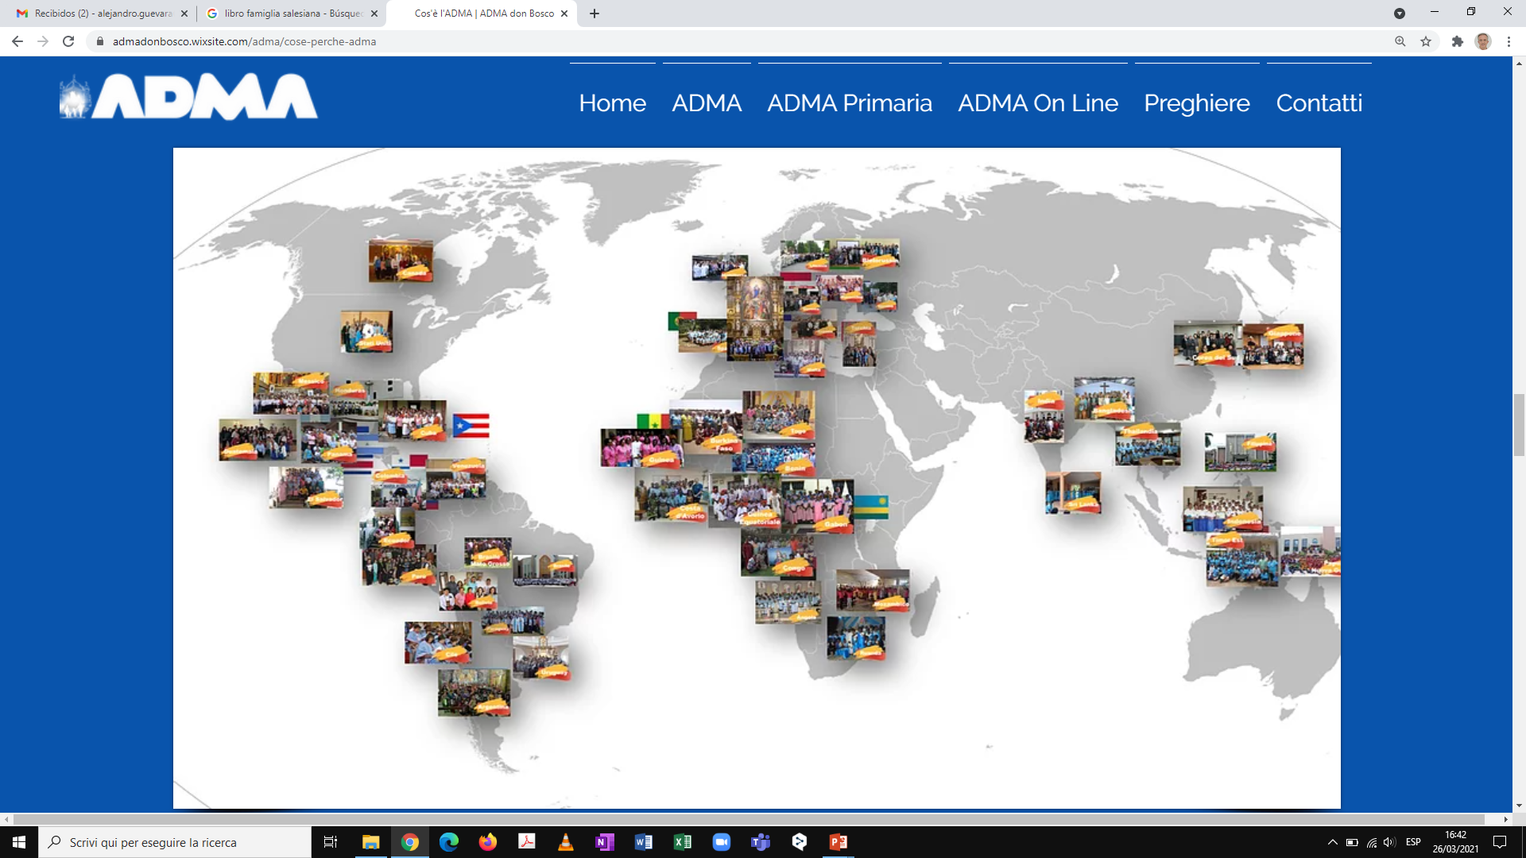
Presentation
GC28 SDB
Postcapitular considerations
Sources for the making of the ADMA guidelines
RM + Council: Programming 2020-2026
Priorities
Program Salesian Family Secretariat
Salesian Family Charismatic Identity Charter (2012)
ACG 340 Entrust, have trust and smile
ADMA 150th anniversary
Reality of the world ADMA
In continuity with previous orientations
Progressive Knowledge and accompaniment

Slide 4
Presentation
Living" guidelines
Continuously developing process
“Placing" this presentation in the right place
ADMA Valdocco Council
Approves, promotes, works
Help, support, service
Local animation
Enlighten your service
Respecting autonomy, inculturation
Fostered by the fire of Marian love

Slide 5
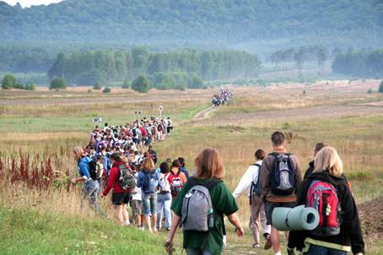
Aim
Objectives towards us lead in the next 4 work years - Strategic planning 2021-2025.
INITIATE
A world spiritual animation style which allows us GROW.
GIVE
A structure which helps us BE.
BUILD
Together, a shared spiritual communion by all ADMAs

Slide 6
AREAS
IDENTITY
KNOW to DEEPEN and LOVE more MARY and JESUS
FORMATION
The ATTITUDE of LOYALTY and PERMANENT RENOVATION
Content of the program
MISSION
SERVICE of the youth of popular classes to take them to SACRAMENT JESUS and TO MARY GREAT HELP
SPIRITUALITY
LIVING a personal relationship in everyday life and with DEPTH

Slide 7
What is ADMA?
IDENTITY
History, origins, target, Don Bosco
KNOW to DEEPEN and LOVE more MARY and JESUS
We are Family
Faith, popular, enculturation

Slide 8
Initial
Aspirants
Permanent
Members - devotees
FORMATION
FORMAZIONE
Directors-Presidents
Local Councils
It is the ATTITUDE of LOYALTY and PERMANENT RENEWAL
É L’ATTEGGIMANETO DI FEDELTÁ E RINNOVAMENTO QUALIFICATO PER VIVERE
Spiritual animators (SDB,FMA, priests, seculars)

Slide 9
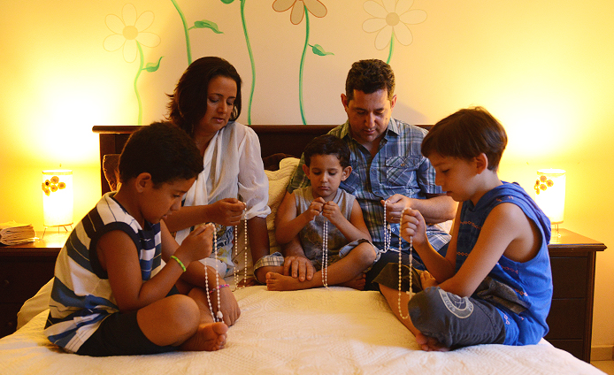
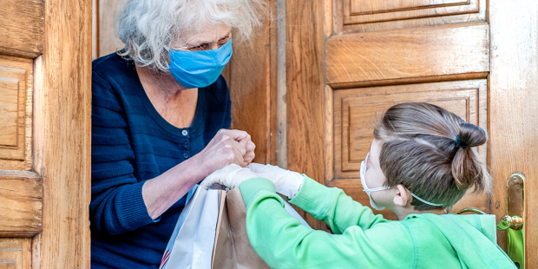
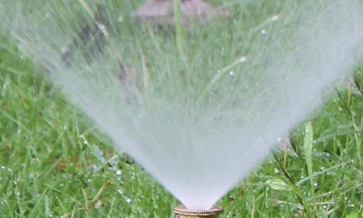
MISSION
SERVICE to the youth and the people classes to take them to SACRAMENTAL JESUS and GREAT HELP OF CHRISTIANS

Slide 10
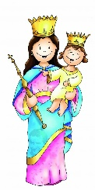
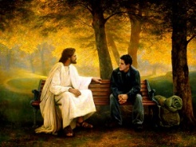
Relationships
Moments
Options
SPIRITUALITY
LIVING a personal relationship in a DEEP everyday nature

Slide 11
FAITH
ATTITUDE
HOW
Systematic Holistic efficient and functional organization
COMMUNICATION

Slide 12
Spirituals animators
SDB, FMA, Priests, Seculars
Secular presidents
SF Teams
COMMUNICATION
Church e local society

Slide 13
Judgement
ATTITUDE
Unity
Communion
Together
Opening

Slide 14
FAITH
FAITH
FAITH
FAITH
FAITH
FAITH
FAITH
FAITH
FAITH
FAITH
FAITH
FAITH
FAITH
FAITH
FAITH
FAITH
FAITH
FAITH
FAITH
FAITH
FAITH
FAITH
FAITH
FAITH
FAITH
FAITH

Slide 15
Reflection TEAMS
01
ADMA – Mary Help of Christian Association
06
ADMA – Youth – Youth Ministry (ADMA rejuvenation)
02
07
Spiritual animator identity
International Congresses of Mary Help of Christians
Levels of organisation of ADMA
03
08
Initial formation (Candidates)
ADMA – Mission – Devotion to Mary Help of Christians
04
09
Local Councils formation
ADMA and the Communication
05
Starting ADMA from zero
10
Mary Help of ALL.
ADMA in non-Catholic, non-religious contexts.

Slide 16
WAY
4. METHODOLOGY
5. TIMING
1. BUILD TEAM WORK
6. DEDICATION
2. SET TARGETS
3. COOR DINATOR

Slide 17
TIMELINE
Do we love
more Mary?
2021-2022
Star Guidelines
3 consideration teamwork
Do we serve
more to poor?
2022-2023
Consolidating the model of animation
3 consideration teamwork
2023-2024
Evaluating and renewing the organisation
3 consideration teamwork
Do we give a better
testimony of our
love to Virgin Mary?

Slide 18
CALENDAR
June – Sending orientations
September – ADMA Programmes – levels.
January – Salesian Family Spirituality Days
April - May – Month of Mary– Novena – Feast of MHC
July – Auguost – Marian Summer (Spiritual Retreats)

Slide 19
DYNAMICS
Monthly
3 per year
All Spiritual Animators
PROVINCIAL
STAFF
Spiritual Anim. SDB+FMA+LAY
REGIO NAL
Online
Spiritual Animator
1 per year (or twice)
Online
2 per year
Online
Prayer
Meetings

